Slide 1
East Hill Foundation

Slide 2
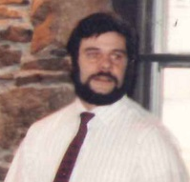
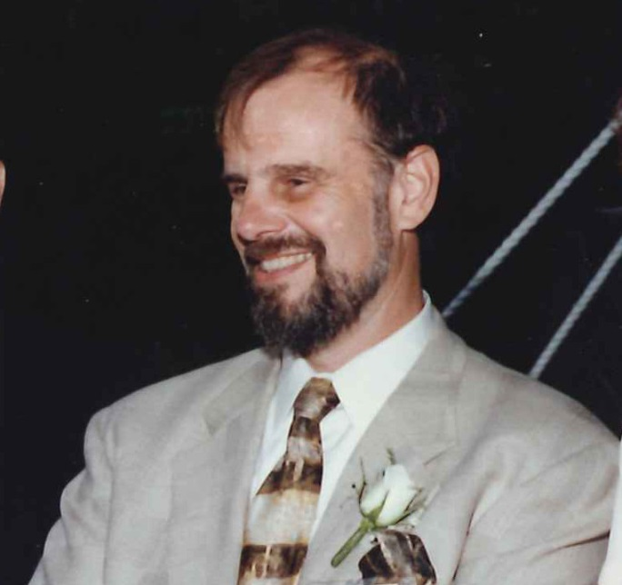
It Started with a Vision
A family tradition of stewardship
Notes:
How presentation will benefit audience: Adult learners are more interested in a subject if they know how or why it is important to them.
Presenter’s level of expertise in the subject: Briefly state your credentials in this area, or explain why participants should listen to you.

Slide 3
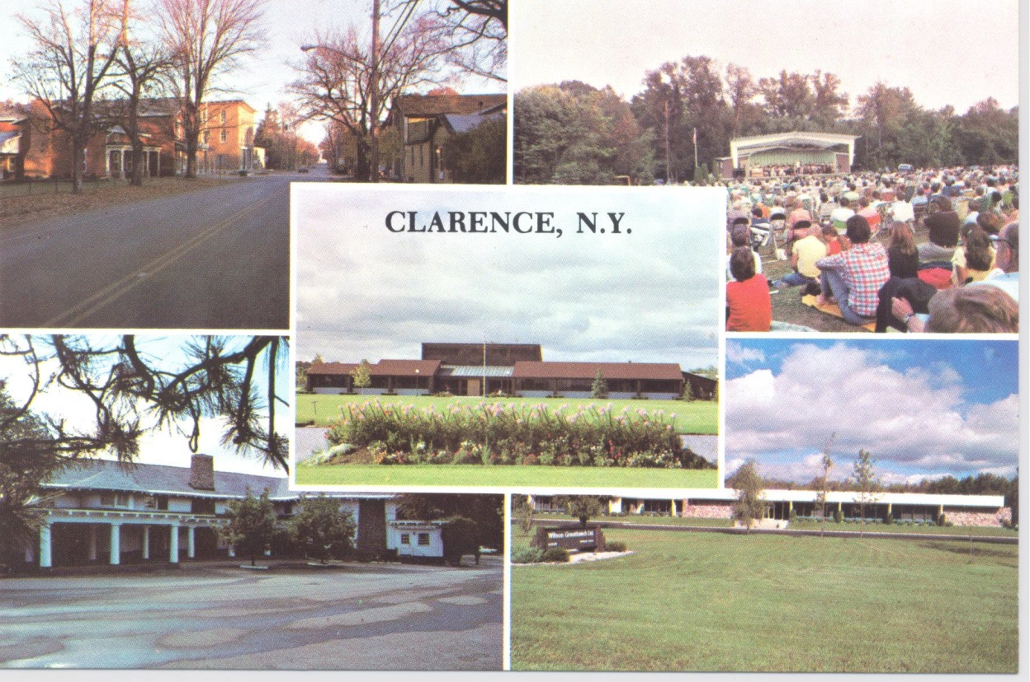
1986
East Hill Foundation was established to assist Clarence, Akron, and Newstead communities
First Meeting 12/22/86
Notes:
How presentation will benefit audience: Adult learners are more interested in a subject if they know how or why it is important to them.
Presenter’s level of expertise in the subject: Briefly state your credentials in this area, or explain why participants should listen to you.

Slide 4
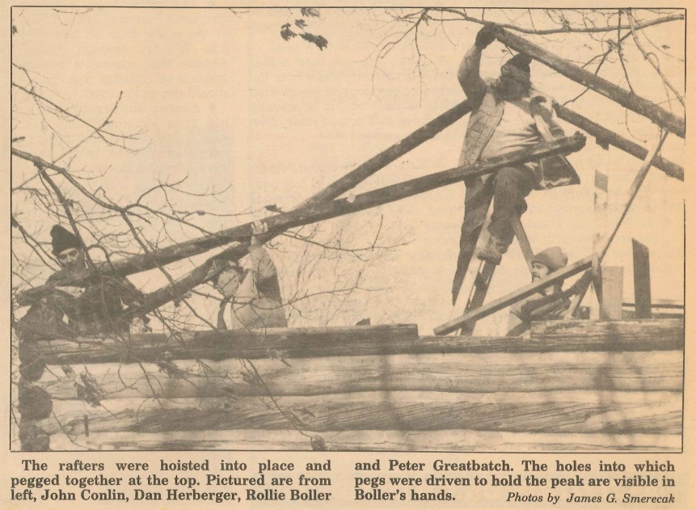
1986
Peter Greatbatch Executive Director of East Hill Foundation
Notes:
How presentation will benefit audience: Adult learners are more interested in a subject if they know how or why it is important to them.
Presenter’s level of expertise in the subject: Briefly state your credentials in this area, or explain why participants should listen to you.

Slide 5
1987
First Grant Recipient
Clarence Senior Citizens Inc.
$5,000 Referral Services
Second Grant Recipient
Clarence Historical Society
Used Copy Machine for Office
Notes:
How presentation will benefit audience: Adult learners are more interested in a subject if they know how or why it is important to them.
Presenter’s level of expertise in the subject: Briefly state your credentials in this area, or explain why participants should listen to you.

Slide 6
1988
Peter initiates a Needs Assessment Survey for the Town of Clarence
Notes:
How presentation will benefit audience: Adult learners are more interested in a subject if they know how or why it is important to them.
Presenter’s level of expertise in the subject: Briefly state your credentials in this area, or explain why participants should listen to you.

Slide 7
1989
East Hill purchases the building for Clarence Historical Museum and lease it to the Town of Clarence with option to purchase.
10465 Main Street, circa. 1843
Notes:
How presentation will benefit audience: Adult learners are more interested in a subject if they know how or why it is important to them.
Presenter’s level of expertise in the subject: Briefly state your credentials in this area, or explain why participants should listen to you.

Slide 8
1990
Logo created by Anne Maciariello
It represents fond memories of growing up on the East Hill in the Clarence Hollow
Notes:
How presentation will benefit audience: Adult learners are more interested in a subject if they know how or why it is important to them.
Presenter’s level of expertise in the subject: Briefly state your credentials in this area, or explain why participants should listen to you.

Slide 9
1991
Peter was instrumental in moving the Goodrich-Landow Log Cabin circa 1825 to the Clarence Museum site
Notes:
How presentation will benefit audience: Adult learners are more interested in a subject if they know how or why it is important to them.
Presenter’s level of expertise in the subject: Briefly state your credentials in this area, or explain why participants should listen to you.

Slide 10
1992
Peter initiates a Needs Assessment Survey for the Town of Newstead
Notes:
How presentation will benefit audience: Adult learners are more interested in a subject if they know how or why it is important to them.
Presenter’s level of expertise in the subject: Briefly state your credentials in this area, or explain why participants should listen to you.

Slide 11
1992
Grand Opening of the Clarence Historical Museum, purchased with assistance from East Hill Foundation
Notes:
How presentation will benefit audience: Adult learners are more interested in a subject if they know how or why it is important to them.
Presenter’s level of expertise in the subject: Briefly state your credentials in this area, or explain why participants should listen to you.

Slide 12
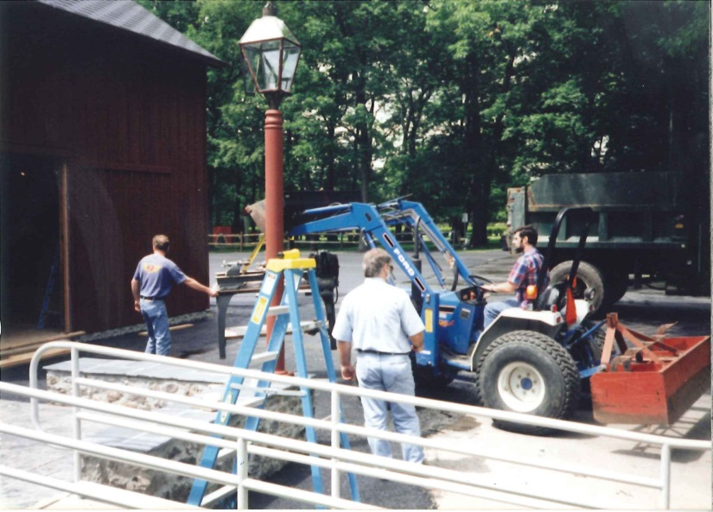
1995
Wilson Greatbatch’s Barn/Workshop moves to Clarence Historical Museum
Notes:
How presentation will benefit audience: Adult learners are more interested in a subject if they know how or why it is important to them.
Presenter’s level of expertise in the subject: Briefly state your credentials in this area, or explain why participants should listen to you.

Slide 13
1998
In Loving Memory of Peter N. Greatbatch
Notes:
How presentation will benefit audience: Adult learners are more interested in a subject if they know how or why it is important to them.
Presenter’s level of expertise in the subject: Briefly state your credentials in this area, or explain why participants should listen to you.

Slide 14
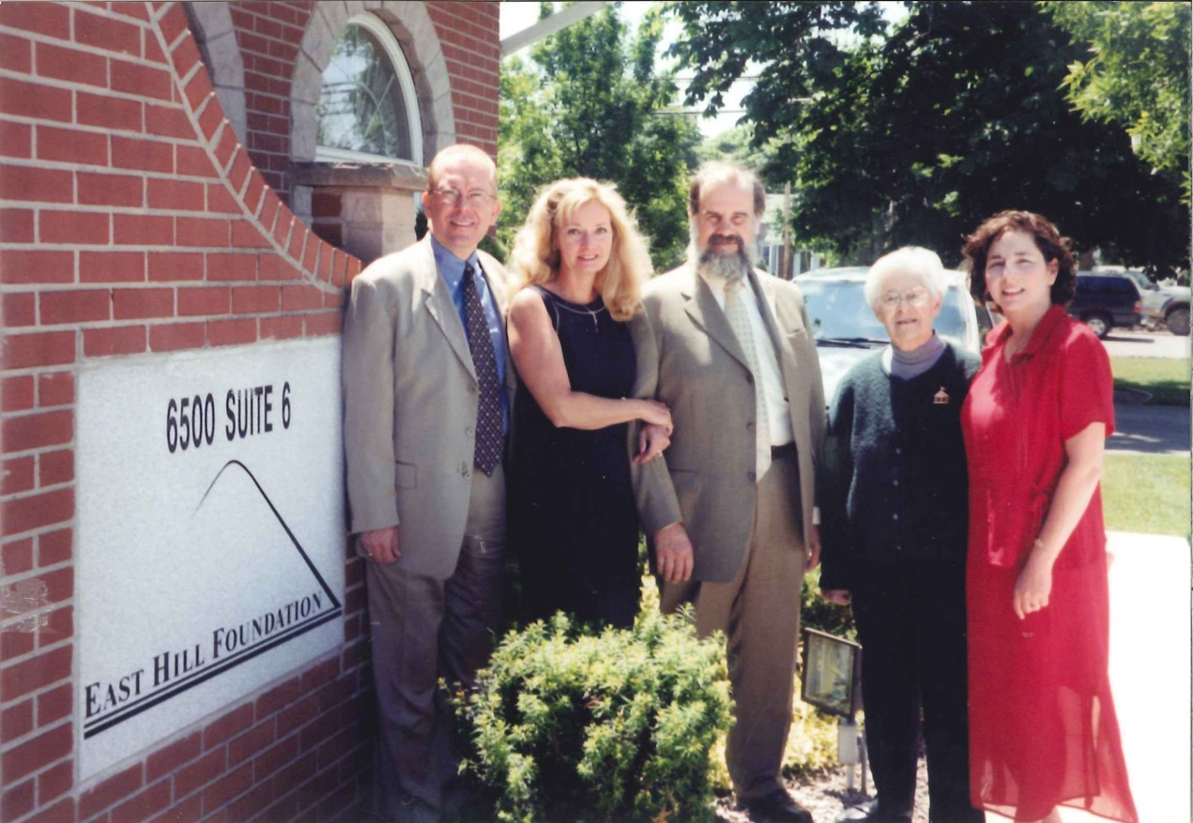
1999
Ami & Warren establish the office in Williamsville
Mission includes grants to WNY and Family interests
Notes:
How presentation will benefit audience: Adult learners are more interested in a subject if they know how or why it is important to them.
Presenter’s level of expertise in the subject: Briefly state your credentials in this area, or explain why participants should listen to you.

Slide 15
2000
Family Meeting held at the Little White House Restaurant
Family Members report on grant projects
Notes:
How presentation will benefit audience: Adult learners are more interested in a subject if they know how or why it is important to them.
Presenter’s level of expertise in the subject: Briefly state your credentials in this area, or explain why participants should listen to you.

Slide 16
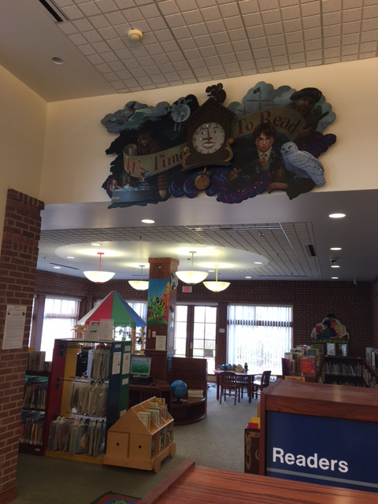
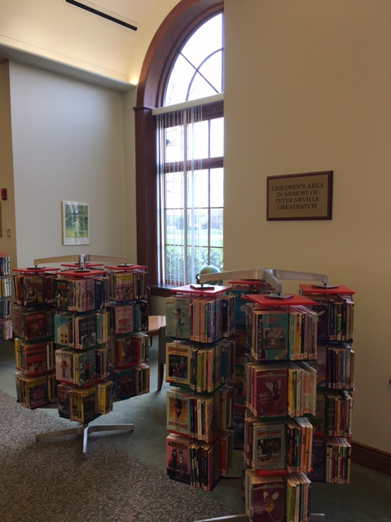
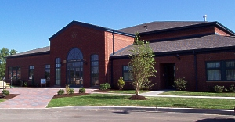
2001
Clarence Public Library opens
Children’s area is named in Memory of Peter Neville Greatbatch
Notes:
How presentation will benefit audience: Adult learners are more interested in a subject if they know how or why it is important to them.
Presenter’s level of expertise in the subject: Briefly state your credentials in this area, or explain why participants should listen to you.

Slide 17
2002
Teaching the family philanthropy
Council on Foundations Conference in San Jose, CA
Notes:
How presentation will benefit audience: Adult learners are more interested in a subject if they know how or why it is important to them.
Presenter’s level of expertise in the subject: Briefly state your credentials in this area, or explain why participants should listen to you.

Slide 18
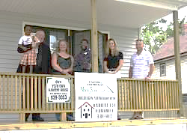
2004
NxGen Giving Program
Jenny, Marcy, Ericka, Jimmy, Cindy, Ken, James, Jennifer, Emily and Cody participate
Notes:
How presentation will benefit audience: Adult learners are more interested in a subject if they know how or why it is important to them.
Presenter’s level of expertise in the subject: Briefly state your credentials in this area, or explain why participants should listen to you.

Slide 19
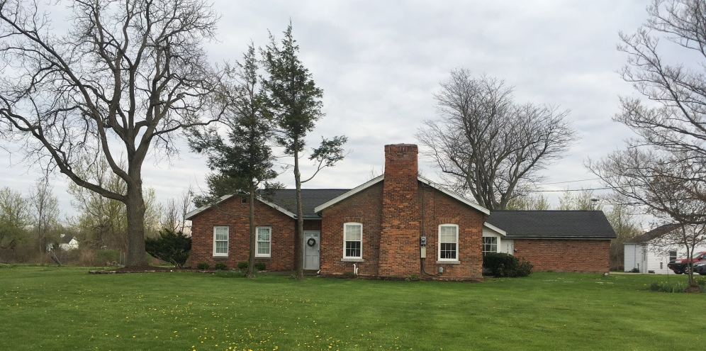
2007
E & W G Foundation becomes a subsidiary of East Hill Foundation
A family tradition of stewardship
Notes:
How presentation will benefit audience: Adult learners are more interested in a subject if they know how or why it is important to them.
Presenter’s level of expertise in the subject: Briefly state your credentials in this area, or explain why participants should listen to you.

Slide 20
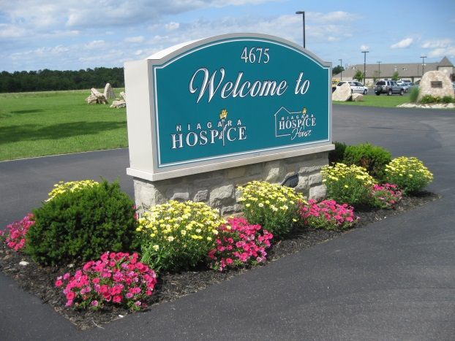
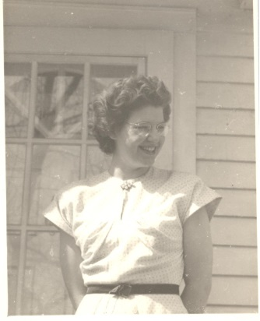
2008
Niagara Hospice opens
Entrance in Memory of “Aunt” Sally Manning
Notes:
How presentation will benefit audience: Adult learners are more interested in a subject if they know how or why it is important to them.
Presenter’s level of expertise in the subject: Briefly state your credentials in this area, or explain why participants should listen to you.

Slide 21
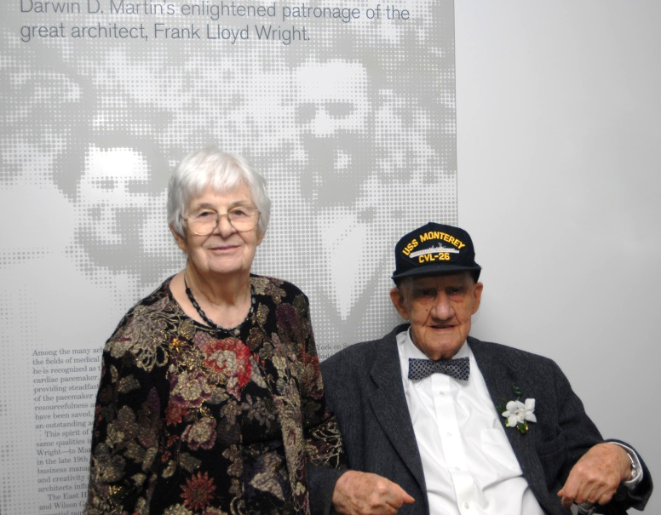
2009
The Eleanor & Wilson Greatbatch Pavilion opens at the Martin House Complex
Notes:
How presentation will benefit audience: Adult learners are more interested in a subject if they know how or why it is important to them.
Presenter’s level of expertise in the subject: Briefly state your credentials in this area, or explain why participants should listen to you.

Slide 22
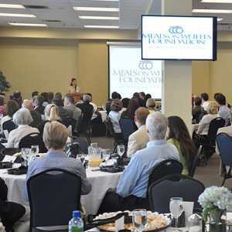
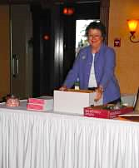
2010
Sustainable Funding Program begins
Notes:
How presentation will benefit audience: Adult learners are more interested in a subject if they know how or why it is important to them.
Presenter’s level of expertise in the subject: Briefly state your credentials in this area, or explain why participants should listen to you.

Slide 23
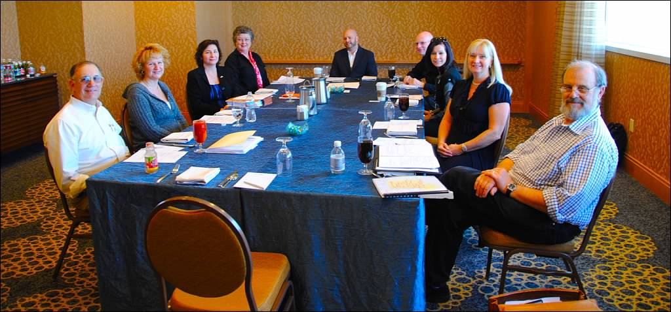
2010
Council on Foundations Conference in San Diego, CA
Meeting with Founder of Benevon
Notes:
How presentation will benefit audience: Adult learners are more interested in a subject if they know how or why it is important to them.
Presenter’s level of expertise in the subject: Briefly state your credentials in this area, or explain why participants should listen to you.

Slide 24
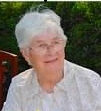
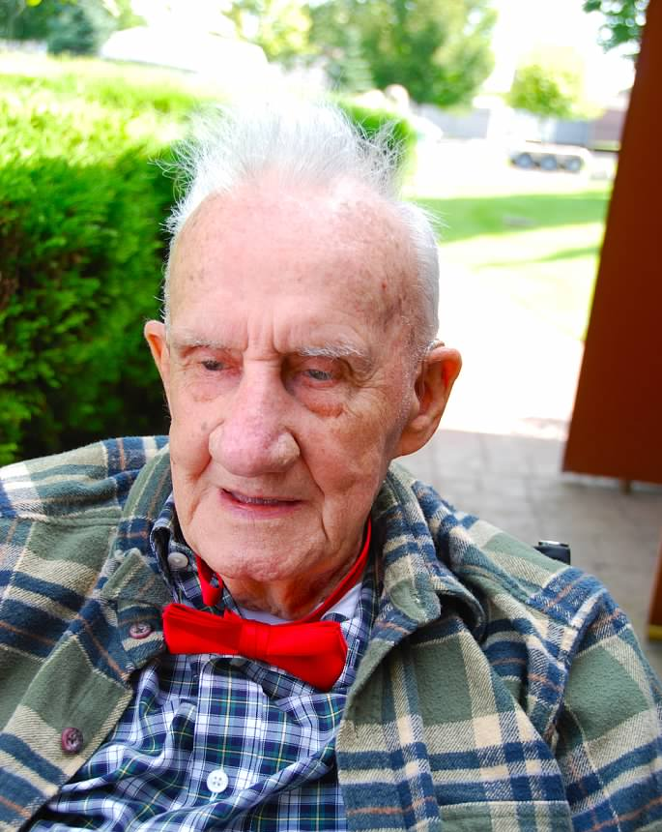
2011
Eleanor & Wilson: Celebrating their life
Notes:
How presentation will benefit audience: Adult learners are more interested in a subject if they know how or why it is important to them.
Presenter’s level of expertise in the subject: Briefly state your credentials in this area, or explain why participants should listen to you.

Slide 25
2011
Ami & Warren donate 17 Island Street property
Island Street Foundation, Inc. becomes a subsidiary of East Hill Foundation
Notes:
How presentation will benefit audience: Adult learners are more interested in a subject if they know how or why it is important to them.
Presenter’s level of expertise in the subject: Briefly state your credentials in this area, or explain why participants should listen to you.

Slide 26
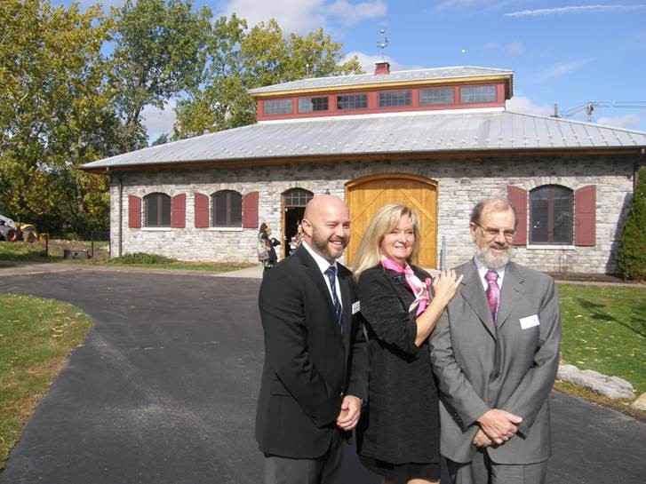
2012
Groundbreaking for new East Hill Foundation Office in North Tonawanda
Notes:
How presentation will benefit audience: Adult learners are more interested in a subject if they know how or why it is important to them.
Presenter’s level of expertise in the subject: Briefly state your credentials in this area, or explain why participants should listen to you.

Slide 27
2013
East Hill Foundation moves to 17 Island Street
North Tonawanda Grant Program begins
Notes:
How presentation will benefit audience: Adult learners are more interested in a subject if they know how or why it is important to them.
Presenter’s level of expertise in the subject: Briefly state your credentials in this area, or explain why participants should listen to you.

Slide 28
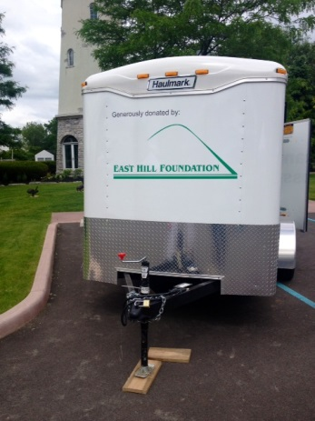
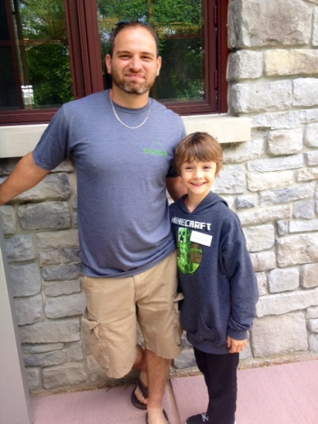
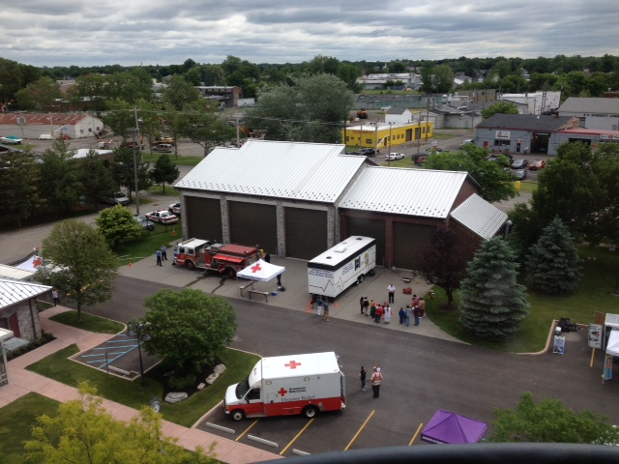
2014
Educational programs begin
Property becomes available for nonprofit events
Notes:
How presentation will benefit audience: Adult learners are more interested in a subject if they know how or why it is important to them.
Presenter’s level of expertise in the subject: Briefly state your credentials in this area, or explain why participants should listen to you.

Slide 29
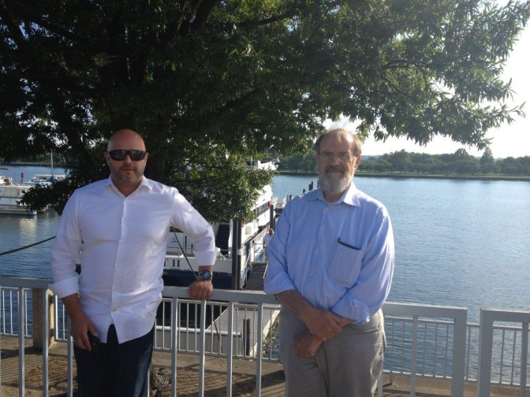
2015
Ken Dulian promoted to Executive Director
Notes:
How presentation will benefit audience: Adult learners are more interested in a subject if they know how or why it is important to them.
Presenter’s level of expertise in the subject: Briefly state your credentials in this area, or explain why participants should listen to you.

Slide 30
2016
Buffalo Niagara Riverkeeper establishes Satellite Office at 17 Island Street to bring educational programs to Niagara County
Notes:
How presentation will benefit audience: Adult learners are more interested in a subject if they know how or why it is important to them.
Presenter’s level of expertise in the subject: Briefly state your credentials in this area, or explain why participants should listen to you.

Slide 31
2016
Grants to the community to date total more than $16,041,883
Notes:
How presentation will benefit audience: Adult learners are more interested in a subject if they know how or why it is important to them.
Presenter’s level of expertise in the subject: Briefly state your credentials in this area, or explain why participants should listen to you.

Slide 32
2016
Thank you Warren for your love of philanthropy, your dedication to family, and your steadfast leadership!
Notes:
How presentation will benefit audience: Adult learners are more interested in a subject if they know how or why it is important to them.
Presenter’s level of expertise in the subject: Briefly state your credentials in this area, or explain why participants should listen to you.

Slide 33
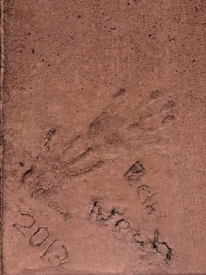
Looking to The Future…
Continue the family legacy and the Gift of Giving
Notes:
How presentation will benefit audience: Adult learners are more interested in a subject if they know how or why it is important to them.
Presenter’s level of expertise in the subject: Briefly state your credentials in this area, or explain why participants should listen to you.

Slide 34
East Hill Foundation
Contact: Kenneth Dulian, Executive Director
Michele Schmidt, Grants Director
www.easthillfdn.org

